Slide 1
Introduction and Overview Part II

Slide 2
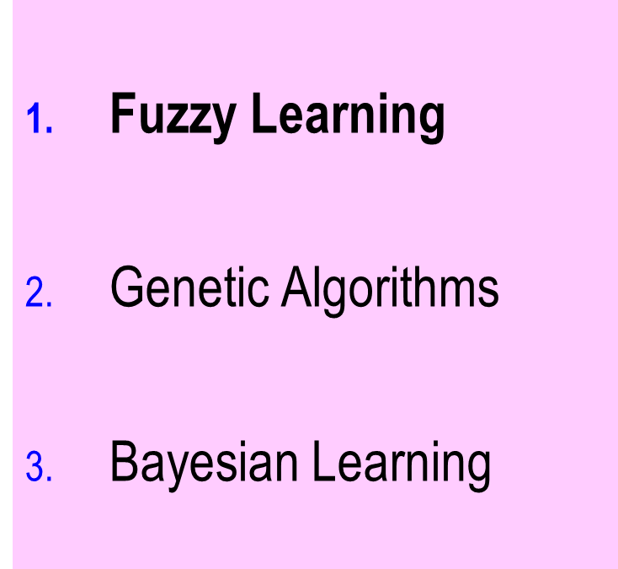
Introduction Part II
Notes:
To complete our introduction to machine learning, we will preview fuzzy methods (suitable for dealing with rules that are verbal but contribute to a numerical output), genetic algorithms (which synthesize—or create—artifacts), and Bayesian learning (which exploits the mathematics of probabilities).

Slide 3
Fuzzy Rules
Notes:
The term “fuzzy” was coined by Lotfi Zadeh as a means of doing engineering (initially) in the context of the real world—where matters are rarely black and white.

Slide 4
Fuzzy Systems: What?
A problem-solving technique for problems whose mechanisms are understood at a verbal level only.
Notes:
Fuzzy systems are useful when words describe the way that the system operates. In the fuzzy approach, nouns (e.g., house) have values (e.g., small, medium, or large). The idea is to convert these to numericalform. We will discuss later how the numerical conversion is done.

Slide 5
Fuzzy Systems: Use when ...
Input
Model
Output
... the model is understood in terms of relatively few key essentially imprecise words, and which requires little inference.
Notes:
Humans are able to perform many tasks naturally that are actually quite complicated when you try to break them down and program them—such as backing up a trailer.
Unlike (classical) expert systems, fuzzy systems may apply only if reasoning is not required. (Recall that reasoning concerns the processing of logic such as “if A implies B and B implies C, then A implies C.” In machine learning, it may be too much to expect to learn rules that are usable in reasoning. Hence fuzy rules may be a more appropriate goal.

Slide 6
Sample Applications of Fuzzy
Most Scientific and engineering fields
  Chemistry
  Physics
Data Analysis
Control of processes in factories
Anti-shake cameras
Data mining
…
http://www.it.uom.gr/pdp/DigitalLib/Fuzzy/fuzzy_soft.htm
Notes:
Fuzzy logic has been applied to a wide variety of scientific and engineering disciplines.

Slide 7
Fuzzy Control System: Example
Demo: Capturing characteristics:
Fuzzy variable greedy; values somewhat, medium, very.
https://www.youtube.com/watch?v=5VJggt2moF8
Balancing a stick.
Notes:
In the demonstration at https://www.youtube.com/watch?v=5VJggt2moF8 , the behavior of sprites is expressed in terms of the values (somewhat, medium, very) of a fuzzy variable greedy.
One of the earliest demonstrations of fuzzy expert systems was the automated balancing of a stick (known as the inverted pendulum problem).

Slide 8
Fuzzy Systems: Input
Input
Model
Output
Exact e.g.
  1.237
  “rod is at -10⁰, angular velocity 30⁰ per second”
Notes:
Contrary to what you might expect, the inputs to a fuzzy system are usually precise. For example, the stick is balanced by feeding in its angle and the twisting speed.

Slide 9
Fuzzy Systems: Output
Input
Model
Output
Exact e.g.
  “move base left at 10 feet per second”
  “take 17 milligrams of aspirin”
Notes:
The output is are also numerical: e.g., the speed of the balancing stick’s base (how fast it should be moved).

Slide 10
Fuzzy Logic: Model
Identify relevant qualities (e.g., growth)
Identify the values of each quality (e.g., low, medium, high)
Encode the knowledge as if-then rules
Convert input to degree of truths
Apply if-then rules in parallel
Extract averaged answer
Notes:
It’s the model where we see the idea of fuzziness at work. The general idea is to express adjectives such as high as they apply to a particular quality such as growth. The pair, such as low growth (applied to a stock, for example) become part of if-then rules. The rules make up the model.

Slide 11
Fuzzy Linguistic Variable Temperature
Definition of Value Hot as Applied to Temperature
degree to which 65C is Hot
1
Hot
0
0 C
50 C
65 C
80 C
Notes:
The figure shows how the adjective Hot, applied to temperture, is converted to a numerical form. It says, for example, that 0º is Hot to the degree 0, and that 80º is entirely Hot.

Slide 12
Definition of Values VSmall, Vlarge
Applied to Bank Balance
1
VSmall
VLarge
$100
$10,000
Notes:
The figure shows reasonable fuzzy values for Very Small and for Very Large as applied to Bank Balance. When we study fuzzy systems in detail, we’ll delve into how rules are formed with these, and applied.

Slide 13
Fuzzy Systems: Learning
Fuzzy rules may sometimes be inferred from data
Recognizing signals
  voice recognition
Steadying Cameras
Control
  e.g. subway
Fuzzy System Examples

Slide 14
Fuzzy Systems: Characteristics 1
Easy to conceptualize (+)
Knowledge easy to express (+)
Represents domain experts well (+)
Potentially very fast (+)
Notes:
Since fuzzy systems primarily use words, they are intuitive. They do not involve learning or chains of reasoning, and so they are generally quite fast in execution.

Slide 15
Fuzzy Systems: Characteristics 2
Cannot explain itself well(-)
Cannot handle chained reasoning (-)
Reliability empirical (-)
Hard to translate to & from numbers (-)
Hard (impossible?) to prove correct (-)
Knowledge must be collected (-)
  arduous
  inexact
Notes:
On the other hand, the translation to and from numbers, while surprisingly successful, can be verified only empirically (i.e., via trial and measurement rather than by anything resembling a proof). As with expert systems, knowledge collection can be expensive in terms of time.

Slide 16
Introduction Part II
Fuzzy learning
Genetic Algorithms
Bayesian Learning
Notes:
The next technology that we will cover in this course, genetic algorithms, mimics the idea of evolution to create artifacts.

Slide 17
Genetic Algorithms
Demo: Learning How to Eat
http://math.hws.edu/eck/jsdemo/jsGeneticAlgorithm.html
Notes:
A genetic algorithm concerns an entity that we are trying to evolve into a better and better version. For example, the entities at http://math.hws.edu/eck/jsdemo/jsGeneticAlgorithm.html are sprites capable of eating food (by simply running into it at a location). In this case, “better” translates into “better able to feed itself.” The sprites all obey rules about movement, and it’s those rules we want to improve.
The way that entities in a GA improve is by evolving through time in a group. In the demo, there are several sprites.

Slide 18
Genetic Algorithms: What?
A problem-solving technique for choosing among many separate alternatives.
Notes:
The “alternatives” in the sprite example consist of the different possible sets of rules.

Slide 19
Genetic Algorithms: Use when ...
Must choose from a discrete set of alternatives
No practical mathematical alternative is known
Alternatives can be conveniently encoded
Notes:
In that GA’s create things, we can think of them as selecting from discrete (rather than continuous) alternatives. In this they are fairly unique as a machine learning approach. Compare “learn to recognize cat pictures” (typically via neural nets) with “learn to design a house.” The first is recognition, the second synthesis.
We do, however, need the candidates to be encoded (“represented”). To select rules is to choose from a discrete set of alternatives. No practical mathematical alternative is at hand. Finally, rules can be conveniently encoded.

Slide 20
Sample Applications
Breed super-fast Formula One race cars
  (Wired News (June 18, 2004)
Mobile robots
Design
  Antennas
  Jet engines (GE)
Synthesizing programs
  Koza: genetic programming
Notes:
GA’s have been used for many applications. An interesting area of exploration, pioneered by Koza and others, is genetic programming, in which, to solve problems, a program is synthesized that solves them. Programs, after all, consist of the selection of discrete commands.

Slide 21
Genetic Algorithms: Example
Finding a route to a desired object
https://www.youtube.com/watch?v=XcinBPhgT7M
Notes:
In the example at https://www.youtube.com/watch?v=XcinBPhgT7M, the goal is for a snake to locate a mouse before it senses danger. We assume that each route consists of a sequence of straight segments. A GA would employ a set of snakes, starting with random routes, and improve on the routes by selecting good parts. The simulation also shows that an occasional (random) mutation is helpful—often crucial.

Slide 22
Genetic Algorithms: Examples
Choose among routes
Choose among designs
Choose among programs
  see Koza: program discovery

Slide 23
G. A.’s: Application
Jet engine design (GE)
  combine with expert system
Bus scheduling (Hitachi)
Breed avatars and agents
  fit for dynamic environments

Slide 24
Application of GA to Feature Subset Selection
Problem: Given 19 features for hepatitis test, select a significant subset on which to perform analysis.
Result of GA application: 9 features selected, 97% accuracy
Yang & Honavar; IEEE Intelligent Systems March/April 1998
Notes:
Data and parameter overload is a common problem. In this early example, a GA is applied to parameter selection itself. As will be seen, such set-theoretic applications avoid GA pitfalls where only some bit strings represent real candidates. The latter inhibits what you can do with bit strings.

Slide 25
Demo
Learning How to Eat
http://math.hws.edu/eck/jsdemo/jsGeneticAlgorithm.html
Notes:
In the demonstration at http://math.hws.edu/eck/jsdemo/jsGeneticAlgorithm.html, the green dots are food for the sprites (in red). The latter learn rules about movement.

Slide 26
Genetic Algorithms: Input
Input
Model
Output
Data
Notes:
GA’s learn from behaving in an environment. One can describe environments as essentially data.

Slide 27
Genetic Algorithms: Model
Input
Model
Output
Characteristics of goal
e.g.
  cloth width, definition of “waste”
  complete pattern specification
    requires encoding
Notes:
GA’s are, like NN’s, essentially “dumb” in that they do not explicitly form understanding. The model is characterized mainly by the evaluation criterion—a numerical measure of the fitness of a candidate. For example, if the GA is for finding a cut of a dress pattern from a roll of cloth, then amount of waste would be a measure.

Slide 28
Genetic Algorithms: Output
Good answers
  much better than trial-and-error
  not optimal
Notes:
As with most machine learning technologies, we usually do not obtain absolute optimal solutions, but ones much better than trial-and-error.

Slide 29
Genetic Algorithms: Model
Convert possible solutions to bit strings.
Select a small set of these.
Mimic evolutionary processes to evolve this set into better and better solutions.
Notes:
In order to deal with and combine parts of candidates, we need a uniform representation capable of being manipulated. Bit strings are ideal for this.
GA’s evolve by using a small set of candidates from which new populations are created. The evaluation function is used for this purpose.

Slide 30
Model: Evolutionary Computations
sample
+ rate
Unrated
[population]
Rated
Finite sample
Angeline, IEEE Expert, June 1995
Notes:
The fundamental GA cycle was described by Angeline in 1995. It begins with a defined population of alternatives—usually much too large to actually list. A relatively small sample if chosen from it, and rated (evaluated).

Slide 31
Model: Evolutionary Computations
sample
+ rate
Unrated
[population]
Rated
Finite sample
mutate
select
Children
reproduce
Parents
Angeline, IEEE Expert, June 1995
Notes:
Favorable pairs are selected from this sample, and a reproduction process produces children, which replace members of the sample. To avoid in-growing characteristics, there is occasional mutation. The process is repeated with the resulting sample.

Slide 32
More Generally: Biomorphic Software
Inspiration for solving problems from natural world
Collective interaction
Autonomous action
Emergence
Local information and interaction
Birth and death
Adaptation
Evolution
Lodding; Queue June 2004
Notes:
Genetic algorithms are part of a family of techniques inspired by biology, as on the list. In all cases, a population evolves over epochs into improved solutions.

Slide 33
1. Setup
1. encode input candidates as binary strings
2. select [unrated] subset at random
x²
evaluation function
256
x
0 31
16
eventual answer
10000
Notes:
Goldberg demonstrated a simple GA that selects the integer between 0 and 15 whose square is maximal (obviously, 15). The numbers are represented as their binaries. A sample of 4 is selected to evolve.

Slide 34
2. Select Parameter Subset At Random [“unrated”]
01101
11000
01000
10011
e. g.
Notes:
These are the four selected at random.

Slide 35
3. Apply Selection, Reproduction then Mutation
3.1 Selection:
produce new members
3.2 Reproduction:
combine pairs by crossover
3.3 Mutation:
alter randomly
Notes:
After selection of the sample, this figure shows the next three steps. When we study GA’s in depth, reproduction described here by “combine pairs by crossover.”

Slide 36
Genetic Algorithms: Characteristics
Slow (-)
May be difficult to encode (-)
Difficult to handle restrictions (-)
Cannot explain itself understandably(-)
Requires lots of work by hand (-)
No model needed (+)
Handles discrete outcome sets (+)
Notes:
A frequent major disadvantage of GA’s is that the evaluation function consumes considerable time. Instances must be represented in the form of bits or their equivalent. Furthermore, in the real world, mathematical combination of instances may not produce legitimate instances of the population.
Unlike expert systems, GA’s do not explain themselves. There is also a unique aspect to each of them, so that uniform tooling is not as successful as in other ML technologies.
The major advantages are that no model is needed, and that GA’s create discrete (separate) solutions—typically combinatorial options.

Slide 37
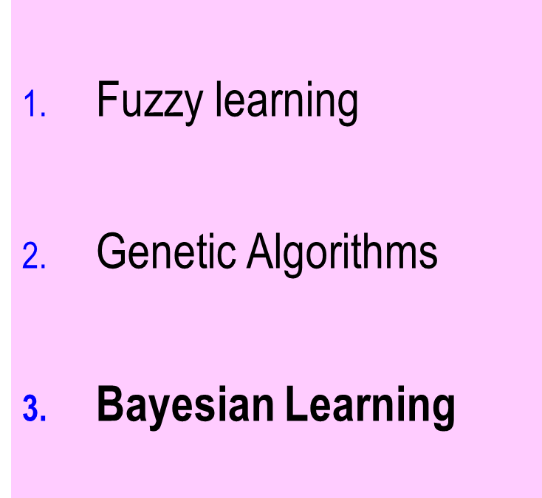
Introduction Part II
Notes:
The final ML technology we’ll summarize is Bayesian Learning. This goes back over 200 years to Bayes’ work on conditional probability—the probability of an event E given and event G.
It was recognized by ML researchers that this is a way of viewing how a system could learn the effect of G on E. The advantage is that the power of probability theory can be brought to bear on ML.

Slide 38
Predict Based on Data
Example (Russell & Norvig p802):
5 types of bags of identically wrapped candy;
h₁ : 100% cherry or
h₂ : 75% cherry + 25% lime or
h₃ : 50% cherry + 50% lime or
h₄ : 25% cherry + 75% lime or
h₅ : 100% lime (e.g., 1 in 10 )
Notes:
In their book on AI, Russel and Norvig give the example of learning from results (data) concerning identical-looking bags of candy. There are 5 types of bags, as in the figure.

Slide 39
Problem:
Based on sample
(e.g., l ,c, c, l, l, c),
predict probability of h₂ , for example.
i.e., probability based on data and on prior probabilities →
Notes:
You select a bag, and unwrap (for example) a lime candy (i), then cherry (c), followed by c, then l, then l, then c. What is the probability that the bag is of type h₂, for example (75% cherry + 25% lime).

Slide 40
Prior Probabilities
h₁ : 100% cherry (e.g., 1 in 10 bags—10%)
h₂ : 75% cherry + 25% lime (e.g., 2 in 10bags—20% )
h₃ : 50% cherry + 50% lime (e.g., 1 in 10bags—10% )
h₄ : 25% cherry + 75% lime (e.g., 2 in 10 bags—20%)
h₅ : 100% lime (e.g., 1 in 10 bags—10%)
Notes:
We’ll solve this example when we study Bayesian methods in depth later in the course. But for now, note that it concerns prior probabilities—known conditional probabilities that are independent of the event under consideration, like those in parentheses above.

Slide 41
Summary

Slide 42
Comparison Table
I=inexact; E=exact; C=continuous.; D=discrete; S=symbolic; N=numeric
Technique | Input | Model | Output
E. S. | I/E, C/D | human | I S
N. N. | E | none | E
F. E. S. | E C | human | N
G. A. | D | none/human | D
Notes:
The figure is a summation of the characteristics of the techniques discussed.

Slide 43
Usability (Adapted from Kasabov p67)
Theory
Statistical
Methods
Rich
Fuzzy
systems
Symbolic
AI
systems
Neural
networks
Genetic
algorithms
Poor
Data
Poor
Rich
Notes:
The figure shows which ML approaches have well-developed theories vs. those that require a lot of data.

Slide 44
Summary
Expert systems
  Inexact model – symbolic
Neural nets
  Inexact model – learn a function
Fuzzy systems
  Inexact model expressed as words
Genetic algorithms
  Construct solution from successful parts

